Slide 1
MATLAB GROUP 8
ASSIGNMENT 2

Slide 2
QN 1
using MATLAB programming ,from the tables visualize the different parameters, patterns ,trends and relationships. Ensure that each plot is saved as an image an annotative label write the script codes

Slide 3
What This Script Does:
Loads all data from 2010–2024 into a single table.
Generates 5 key plots:
Price distribution per year (boxplot).
Average sales volume trend (line plot).
Price vs. Mileage scatter plot (relationship visualization).
Fuel type distribution (bar chart).
Sales classification per region (stacked bar chart).
Saves each plot automatically in a folder called Plot

Slide 4
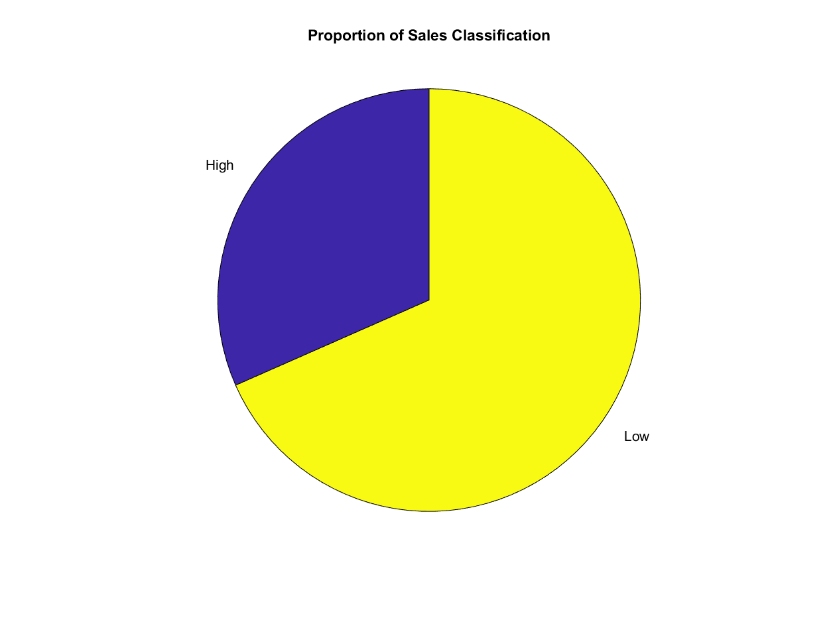

Slide 5
QN 2
in question 2,describe the different statistical data and ensure that you visualize them, ensure that the different attributes collected per individual is detailed enough to describe them use matlab scripts

Slide 6
Key Features of This Solution:
1.Focused Member Profiles:
o Includes only the first set of attributes: name, background, district, tribe, village, religion, interests, and age
o Excludes the last 8 attributes as requested
2.Statistical Analysis:
o Basic statistics for age (mean, median, standard deviation, min, max)
O Distribution analysis for categorical data (tribe, religion, background, district, village)

Slide 7
3. Multiple Visualizations:
Demographic distributions (tribe, religion, background, district, village)
Age distribution
Interests analysis with bar chart and word cloud
Age distribution by background

Slide 8
4. Comprehensive Reporting:
Text-based report with group summary and individual profiles
Diversity analysis
Top interests listing

Slide 9
Instructions:
1. Save this code as a MATLAB script (e.g., group_analysis_simple.m)
2. Run the script to generate all analyses and visualizations
3. The script will create:
o Multiple visualization figures (PNG files)
o Excel file with member data
o MAT file with structured data
o Comprehensive text report

Slide 10
This solution provides a focused analysis of your group members using only the first set of attributes, with statistical insights and visualizations that would be perfect for a presentation or report

Slide 11
